Slide 1
Programming Fundamental
Week 08
Sobia Iftikhar
Sobia.Iftikhar@nu.edu.pk

Slide 2
Class 19

Slide 3
Practice
1. Vary the control variable from 1 to 100 in increments of 1.
for (unsigned int i = 1; i <= 100; ++i)
2. Vary the control variable from 100 to 1 in increments of -1 (i.e., decrements of 1).
for (unsigned int i = 100; i >= 1; --i)
3. Vary the control variable from 7 to 77 in increments of 7.
for (unsigned int i = 7; i <= 77; i += 7)
4. Vary the control variable from 20 to 2 in decrements of -2.
for (unsigned int i = 20; i >= 2; i -= 2)
5. Vary the control variable over the following sequence of values: 2, 5, 8, 11, 14, 17.
for (unsigned int j = 2; j <= 17; j += 3)
6. Vary the control variable over the following sequence of values: 44, 33, 22, 11, 0.
for (unsigned int j = 44; j >= 0; j -= 11)

Slide 4
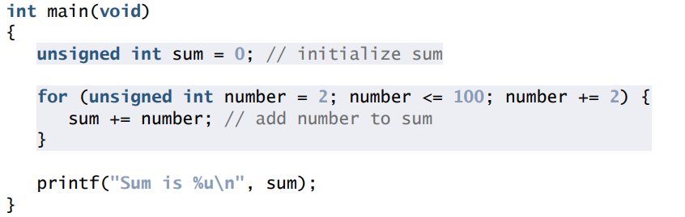
Task
uses the for statement to sum all the even integers from 2 to 10

Slide 5
Task
A person invests $1000.00 in a savings account yielding 5% interest. Assuming that all interest is left on deposit in the account, calculate and print the amount of money in the account at the end of each year for 10 years.
Use the following formula for determining these amounts:
a = p(1 + r)n where p is the original amount invested (i.e., the principal)
r is the annual interest rate (for example, .05 for 5%)
n is the number of years a is the amount on deposit at the end of the nth year.

Slide 6
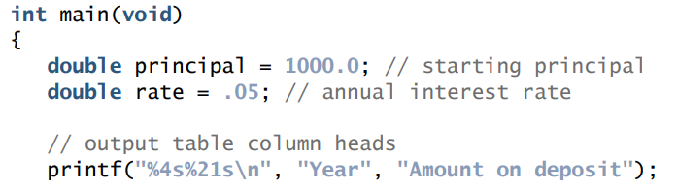
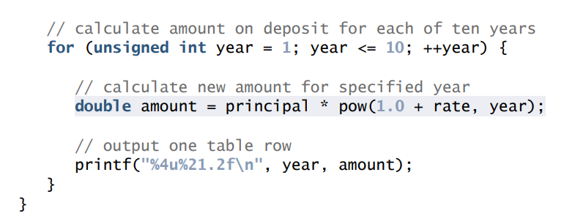
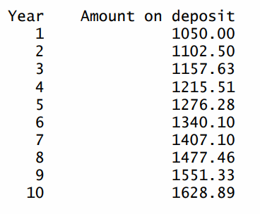
Solution

Slide 7

Exercise
#include <stdio.h>
int main()
{
int n;// variable declaration
printf("Enter the value of n :");
// Displaying the n tables.
for(int i=1;i<=n;i++) // outer loop
{
for(int j=1;j<=10;j++) // inner loop
{
printf("%d\t",(i*j)); // printing the value.
}
printf("\n");
}

Slide 8
Nested Loops
for (initialization; condition; update)
{
for(initialization; condition; update)
{
// inner loop statements.
}
// outer loop statements.
}

Slide 9
Nested While Loop
while(condition)
{
while(condition)
{
// inner loop statements.
}
// outer loop statements.
}

Slide 10
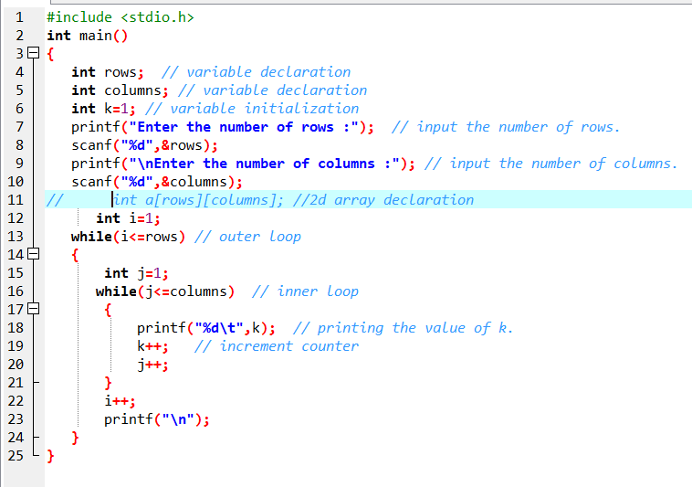
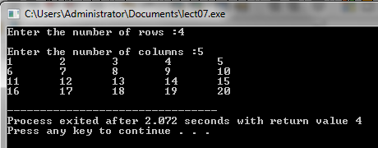
Example

Slide 11
Nested do While()
do
{
do
{
// inner loop statements.
}while(condition);
// outer loop statements.
}while(condition);

Slide 12

Example
int i=1;
do // outer loop
{
int j=1;
do // inner loop
{
printf("*");
j++;
}while(j<=8);
printf("\n");
i++;
}while(i<=4);

Slide 13
Task
Write a program to print all the ASCII values and their equivalent characters using a while loop. The ASCII values vary from 0 to 255.
main() { int i=0; clrscr(); while(i<=255) { printf(" %d %c \n",i,i); i++; } return 0; }

Slide 14
Task
#include<stdio.h>
#include<conio.h>
main() {
int i=1,j;
printf("\nPrime numbers between 1 to 300 are:\n\n");
while(i!=10) {
j=2;
while(j<i) {
if(i%j==0) {
break;
}
j++;
printf(" -- j %d\n",j);
}
if(j==i) {
printf(" %d",i);
}
i++;
printf(" -- i %d\n",i);
}
getch();
return 0;
}
Write a program to print all prime numbers from 1 to 10. (Hint: Use nested loops, break and continue)

Slide 15
Task
#include<stdio.h>
#include<conio.h>
main() {
int i,j,k;
printf("All combinations of 1,2,3 are:\n\n");
for(i=1;i<=3;i++) {
for(j=1;j<=3;j++) {
for(k=1;k<=3;k++) {
printf(" %d%d%d ",i,j,k);
}
}
}
getch();
return 0;
}
Write a program to generate all combinations of 1, 2 and 3 using for loop

Slide 16
Class 20

Slide 17
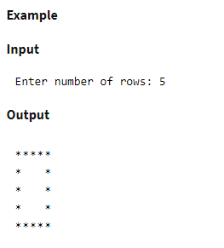
Example
Step by step descriptive logic to print empty square star pattern.
Input number of rows to print from user. Store it in a variable say N.
To iterate through rows, run an outer loop from 1 to N. For that define loop with structure for(i=1; i<=N; i++).
To iterate through columns, run an inner loop from 1 to N. Define loop with structure for(j=1; j<=N; j++).
Inside inner loop print star for first and last row or for first and last column. Which is print star if i==1 or i==N or j==1 or j==N, otherwise print space.
After printing all columns of a row, move to next line i.e. print a blank line after inner loop.

Slide 18
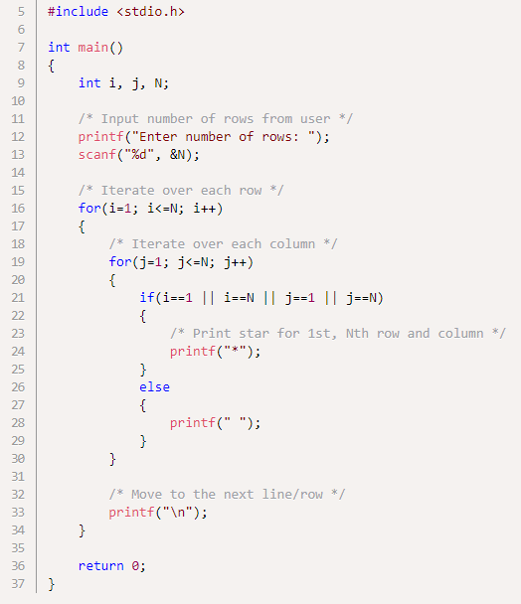
Solution

Slide 19
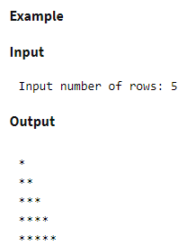
Example
Step by step descriptive logic to print right triangle star pattern.
Input number of rows to print from user. Store it in a variable say N.
To iterate through rows run an outer loop from 1 to N with loop structure for(i=1; i<=N; i++).
To iterate through columns run an inner loop from 1 to i with loop structure for(j=1; j<=i; j++). Inside the inner loop print star.
After printing all columns of a row move to next line i.e. print new line.

Slide 20
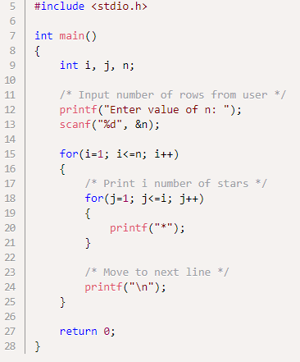
Solution

Slide 21
Loops (Contd)
Write a program to find the factorial value of any number entered through the keyboard.
main() { long i,j,fact=1; printf("Please enter any number: "); scanf("%ld",&i); for(j=i;j>=1;j--) { fact=fact*j; } printf("Factorial value = %ld ",fact); Return 0; }

Slide 22
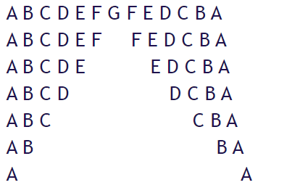
Example
/* loop for making a space between patterns */ for(k=i+1;k<=71;k++) { if(k==71) printf(" "); if(k<71) printf(" "); } /* loop to print descending letters */ for(l=i;l>=65;l--) { if(l==71) { /* to skip printing 'G' twice */ continue; } printf("%c ",l); } printf("\n"); } return 0; }
#include<stdio.h> #include<conio.h> main() { int i,j,k,l; clrscr(); for(i=71;i>=65;i--) { /* loop for printing ascending letters */ for(j=65;j<=i;j++) { printf("%c ",j); }
Write a program to produce the following output:

Slide 23
Class 21

Slide 24
Array
A array is a collection of two or more adjacent memory cells called array element.
We must have to declare the array in memory with particular data types.
double x[8]
In which we instruct the compiler to associate eight memory cell with the name of X.
8 size array with double data type
16.0 | 12.0 | 13.0 | 3.0 | 45.0 | 29.0 | 19.0 | 59.0
X[0] | X[1] | X[2] | X[3] | X[4] | X[5] | X[6] | X[7]

Slide 25
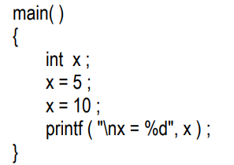
Arrays
What are Arrays ?
No doubt, this program will print the value of x as 10. Why so? Because when a value 10 is assigned to x, the earlier value of x, i.e. 5, is lost. Thus, ordinary variables (the ones which we have used so far) are capable of holding only one value at a time (as in the above example). However, there are situations in which we would want to store more than one value at a time in a single variable.

Slide 26
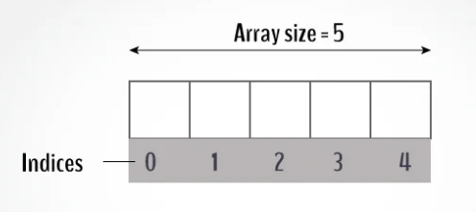

Arrays
An array is a variable that can store multiple values. For example, if you want to store 100 integers, you can create an array for it.

Slide 27
Arrays
Name of array (Note that all elements of this array have the same name, c)
An array is a collection of variables of
a certain type, placed contiguously in
memory.
Array
Group of consecutive memory locations
Same name and type
To refer to an element, specify
Array name
Position number
Format:
arrayname[ position number ]
First element at position 0
n element array named c:
c[ 0 ], c[ 1 ]...c[ n – 1 ]
c[0]
-45
c[1]
6
c[2]
0
c[3]
72
c[4]
1543
c[5]
-89
c[6]
0
c[7]
62
c[8]
-3
c[9]
1
c[10]
6453
c[11]
78
Position number of the element within array c

Slide 28
Arrays (Cont’d)
Array elements are like normal variables
c[ 0 ] = 3;
printf( "%d", c[ 0 ] );
Perform operations in subscript. If x equals 3
c[ 5 - 2 ] == c[ 3 ] == c[ x ]
When defining arrays, specify
Name
Type of array
Number of elements
arrayType arrayName[ numberOfElements ];
Examples:
int c[ 10 ];
float myArray[ 3284 ];
Defining multiple arrays of same type
Format similar to regular variables
Example:
int b[ 100 ], x[ 27 ];

Slide 29
Arrays (Cont’d)
Initializers
int n[ 5 ] = { 1, 2, 3, 4, 5 };
If not enough initializers, rightmost elements become 0
int n[ 5 ] = { 0 } ;
All elements 0
If size omitted, initializers determine it
int n[ ] = { 1, 2, 3, 4, 5 };
5 initializers, therefore 5 element array

Slide 30

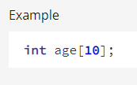
Why do we need an array?
Let’s consider the situation where we need to get 10 student’s age and store it for some calculation. Since age is an integer type, we can store it something like below,
Use Array to store ages

Slide 31


How to declare an array?
For example,
we declared an array, mark, of floating-point type. And its size is 5. Meaning, it can hold 5 floating-point values.
It's important to note that the size and type of an array cannot be changed once it is declared.

Slide 32

How to initialize an array?
It is possible to initialize an array during declaration. For example,

Slide 33
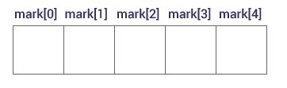
Access Array Elements
You can access elements of an array by indices.
Suppose you declared an array mark as above. The first element is mark[0], the second element is mark[1] and so on.

Slide 34
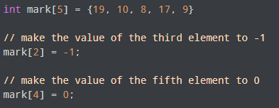
Change Value of Array elements

Slide 35
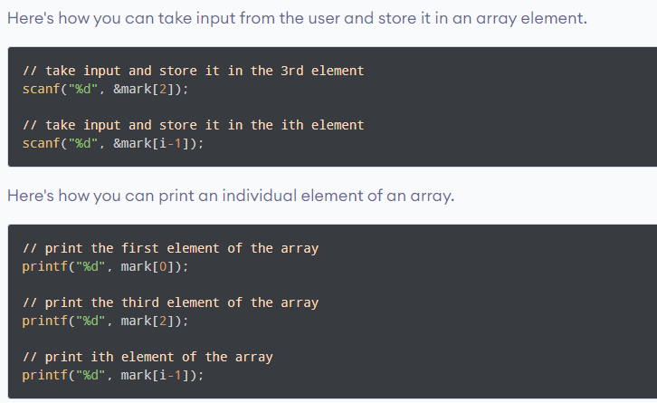
Input and Output Array Elements

Slide 36
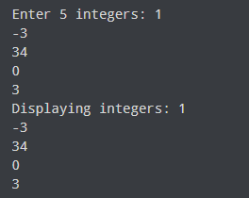
Example
int main() {
int values[5];
printf("Enter 5 integers: ");
// taking input and storing it in an array
for(int i = 0; i < 5; ++i) {
scanf("%d", &values[i]);
}
printf("Displaying integers: ");
// printing elements of an array
for(int i = 0; i < 5; ++i) {
printf("%d\n", values[i]);
}
return 0;
}

Slide 37
Difference
int main()
{
int marks[10], i, n, sum = 0, average;
printf("Enter number of elements: ");
scanf("%d", &n);
for(i=0; i<n; ++i)
{
printf("Enter number%d: ",i+1);
scanf("%d", &marks[i]);
// adding integers entered by the user to the sum variable
sum += marks[i];
}
average = sum/n;
printf("Average = %d", average);
return 0;
}
{
int n, count = 1;
float xF, averageF, sumF = 0;
Scanner sc = new Scanner(System.in);
System.out.println("Enter the value of n");
n = sc.nextInt();
while (count <= n)
{
System.out.println("Enter the "+count+" number?");
Marks = sc.nextInt();
sumF += Marks;
++count;
}
averageF = sumF/n;
System.out.println("The Average is"+averageF);
}
}

Slide 38
Thankyou

